Slide 1
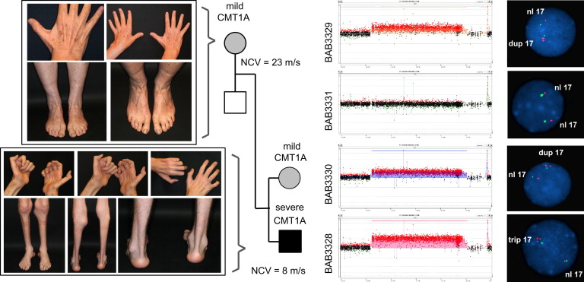
Clinical Phenotypes and Copy-Number Analyses in Family 1
Liu, P., et al. (2014). Mechanism, prevalence, and more severe neuropathy phenotype of the Charcot-Marie-Tooth Type 1A Triplication. American Journal of Human Genetics, 94, 462-469.

Slide 2
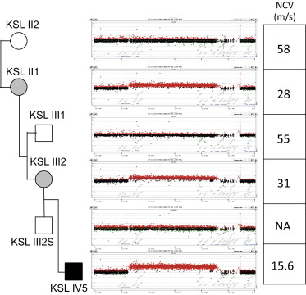
NCVs and Copy-Number Analyses in Family 2
Liu, P., et al. (2014). Mechanism, prevalence, and more severe neuropathy phenotype of the Charcot-Marie-Tooth Type 1A Triplication. American Journal of Human Genetics, 94, 462-469.

Slide 3
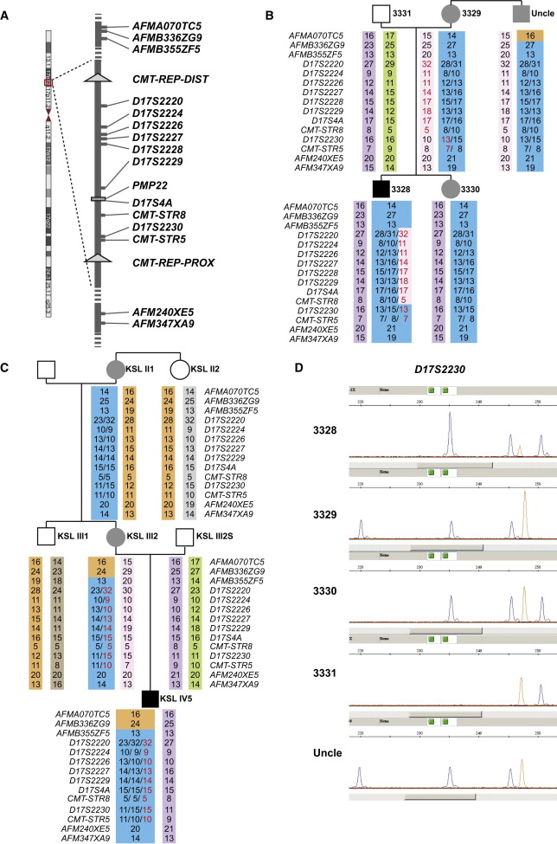
Microsatellite Analysis Results Suggest that de Novo Triplications Arose from Duplications by Different NAHR Mechanisms
Liu, P., et al. (2014). Mechanism, prevalence, and more severe neuropathy phenotype of the Charcot-Marie-Tooth Type 1A Triplication. American Journal of Human Genetics, 94, 462-469.

Slide 4
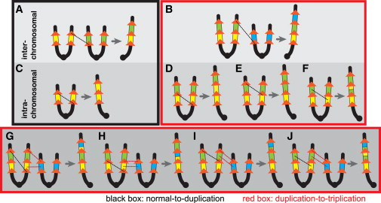
More NAHR Pathway Choices are Available for the Duplication-to-Triplication Process than for the Normal-to-Duplication Process
Liu, P., et al. (2014). Mechanism, prevalence, and more severe neuropathy phenotype of the Charcot-Marie-Tooth Type 1A Triplication. American Journal of Human Genetics, 94, 462-469.

